Slide 1
TWEETER BASED Sentiment ANALYSIS
Deepika Dash
10 March 2016

Slide 2
OBJECTIVE
Sentiment analysis
Most liked features
Competition analysis
Region wise analysis
Discourse analysis

Slide 3
OVERVIEW
WHY TWITTER?
It is for everybody and by everybody.
It is both real-time & history based.
Determination of the sentiment is simpler.
Easily and freely accessible via API.
Publicly available data and hence no copyright issues.
CHALLENGES
Fetching historical tweets from twitter.
Analyzing non-English tweets.

Slide 4




TWITTER ANALYTICS STACK
Source
Processing
Storage
Visualization
Source : Tweets are pulled from twitter using Twitter API. The tweets are filtered for key words like “Hadoop”, “Data Analytics”, “Machine Learning”
Processing : Tweets are then processed(Translation, Sentiment analysis,…) using storm
Storage : The tweets are saved in Hadoop in JSON format
Visualization : NodeJS is a JavaScript library which is used to visualize the processed data

Slide 5

Sentiment Analysis
DATA
The sentiment of the tweets are determined based on a dictionary of more than 2000 words where each word is rated on a scale of -1 to +1.
Support Vector Machine – A supervised machine learning algorithm was also used to determine the sentiment of the tweets
INSIGHT
Sample tweets (classification of Positive, Negative and Neutral)

Slide 6
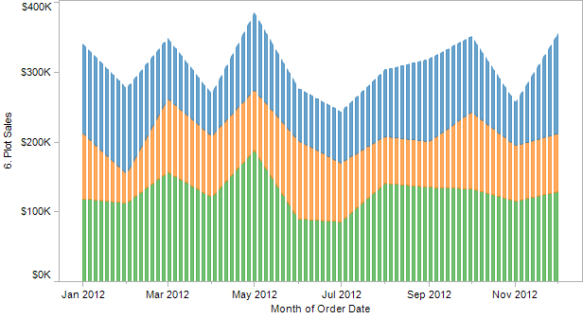
Trend Analysis
DATA
Number of tweets over the period since the launch.
Distribution on tweets sentiments over the timeline
INSIGHT
Popularity of the product on twitter is linked to the releases.

Slide 7
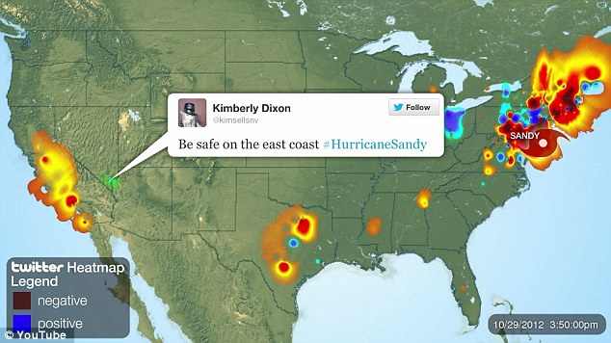
Tweets by location
DATA
Location is determined from the time zone set by the tweeter.
INSIGHT
Tweets observed from locations can be an indication of the awareness of the product.

Slide 8
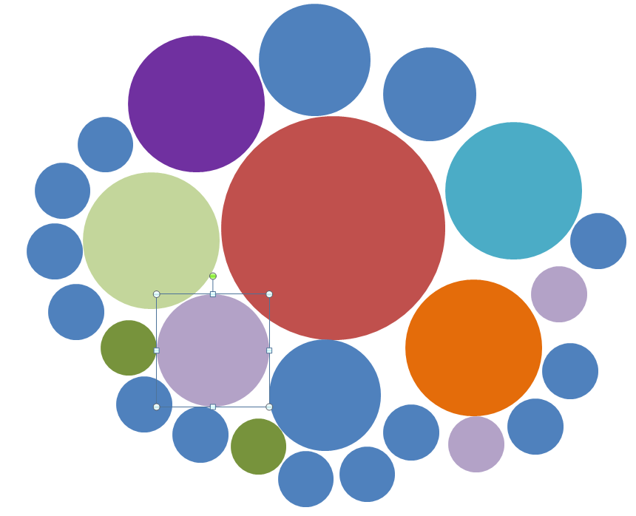
Most popular & Language of tweets
FR
DATA
Most popular tweets are determined by the number of times a tweet
has been retweeted.
40% of the tweets are found to be in non-English languages.
INSIGHT
Most popular tweets can give an indication of the most desired features of hue.
Need to determine the sentiments on tweets in other languanges.
EN

Slide 9
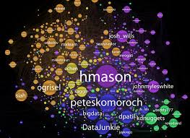
Most Influential tweeters
DATA
People with the maximum number of followers are the influential tweeters
INSIGHT
Gives a view of tweeters who are talking about the product

